Slide 1


PROMETHIEUS TECHNOLOGIES ACQUISITION FUND
Triple One Metals CSE: TONE
Canadian Nickel, Lithium and Gold Projects
Change Is Ubiquitous
Invest in Change

Slide 2

Forward Looking Statements
The following document contains certain forward-looking statements and forward-looking information, which is based on hypothetical data, which includes current expectations, estimates, projections, assumptions and beliefs. By their nature, forward-looking statements and hypothetical data is subject to a number risks and uncertainties, because they relate to future events and circumstances and there are many factors that could cause actual results and developments to differ materially from those expressed or implied by these forward-looking statements. Additional disclosure information regarding the forward-looking statements mythology, assumptions and risks is available for review. These forward-looking statements may be identified by words such as “believes”, “expects”, “anticipates”, “projects”, “projected”, “pro forma”, “intends”, “forecasted”, “forecast”, “assumed”, “should”, “continue”, “seeks”, “may”, “will", "estimates”, “estimated”, “future”, “could”, “probably” or similar words or expressions or by discussion of strategy, goals, plans, intentions or projections of revenues, earnings, segment performance, cash flows, contract awards, market size, industry trends, expenses and future financing.
It is believed that the expectations reflected in the forward-looking statements and forward-looking information are reasonable, but no assurance can be given that these expectations will prove to be correct, and such forward-looking statements and information should not be unduly relied upon, because the actual future results may differ materially from the plans, goals, and expectations set forth in such forward-looking statements.
The forward-looking information and statements are only as of the date they are made. All subsequent written and oral forward-looking statements made are qualified by the cautionary statements in this section. There is no undertaking or assumption of any obligation to update or revise any of the included forward-looking statements or information, whether as a result of new information, changes in expectations or circumstances, future events or otherwise.

Slide 3


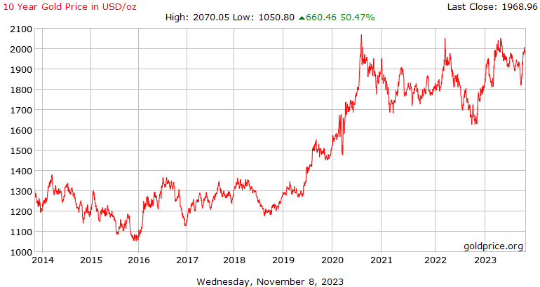
Strong Gold Demand
Breakout
Breakout
Consolidation
Consolidation

Slide 4
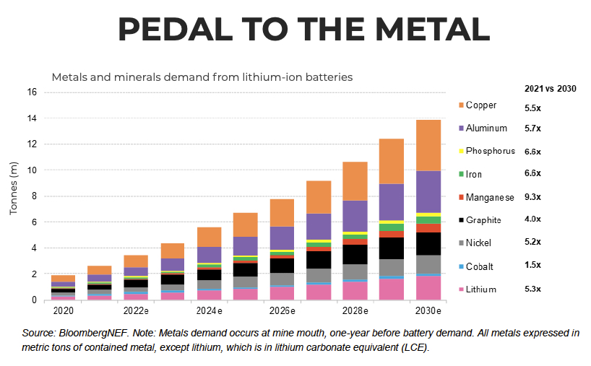
Boom in Canadian Battery Metals

Slide 5
Company
Triple One Metals
Triple One Metals has a portfolio of gold and critical metal projects in mining and mineral-rich Newfoundland and Quebec.
Triple One's plan is to expand into a long-life, financially sound, gold, and critical metal-mining company.
Currently, the company is raising funds to fund gold projects in NFLD and complete work in Quebec.
Commodities such as nickel and copper will be in high demand as a result of the electric vehicle revolution.

Slide 6
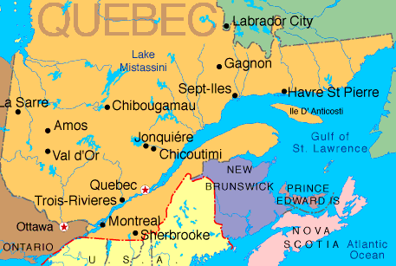
Project Location
Bank Vault Project Located in
Urban-Barry Region

Slide 7
Quebec
Project Details
Bank Vault on Trend with Major Gold Bearing Faults in Urban-Barry Region
The Bank Vault Project is located south-west of Chibougamau and north-east of Val D’Or.
The Project is on Trend with the Windfall, Gladiator and Barry Gold Projects owned by Osisko Metals and Bonterra Exploration.
In Fall 2023, Osisko Metals committed to spend $ 30 million in exploration in the area by optioning projects from Bonterra
The Windfall Resource Estimate, assuming a cut-off grade of 3.50 g/t Au, comprises 811,000 tonnes at 11.4 g/t Au (297,000 ounces) in the measured mineral resource category, 10,250,000 tonnes at 11.4 g/t Au (3,754,000 ounces) in the indicated mineral resource category and 12,287,000 tonnes at 8.4 g/t Au (3,337,000 ounces) in the inferred mineral resource category.

Slide 8
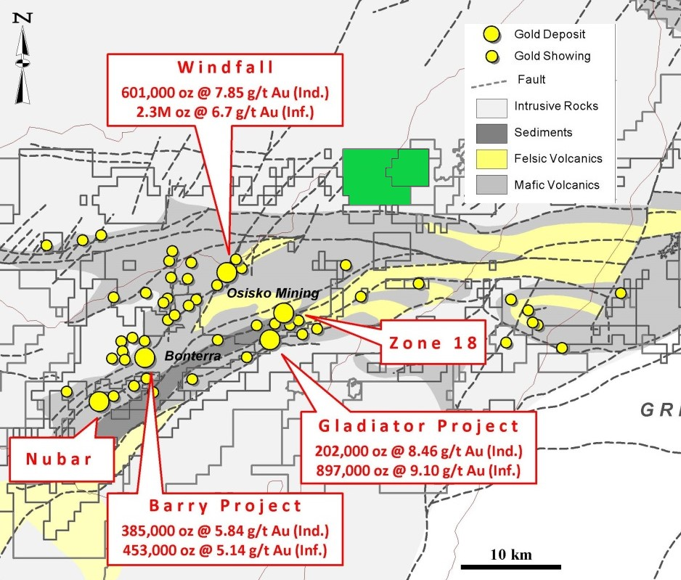
Quebec Gold Project
Gold Mine Developments in Urban-Barry Region by Osisko and Bonterra
Bank Vault and Nickel Showing

Slide 9
Quebec
Project Shear Zones
Multiple Outcrops
at the Nickel Showing Project
Previous work in 2020 identified the ‘Osisko outcrop’ of sheared basalt and gabbro and hosted a east-west dipping 30 cm wide quartz vein which is now part of the Nickel Showing Project, adjoining Bank Vault.
The nearby Discovery Outcrop has an east-west strike of 90 degrees with pyrite present along shear planes.
Five Parallel Shear Zones were traced for 100 metres and are all altered by silica and chlorite, some of which are pictured in the next slide
40 Foot Shear Zone

Slide 10
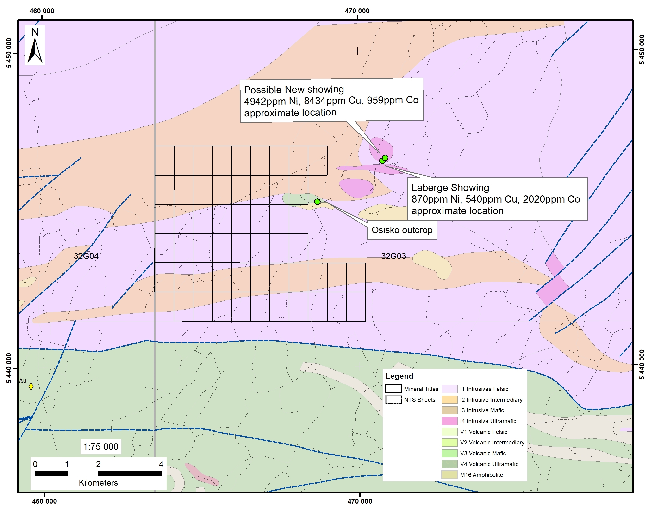
Project Details
Triple One’s Nickel Showing Project
Staked adjacent to Bank Vault

Slide 11
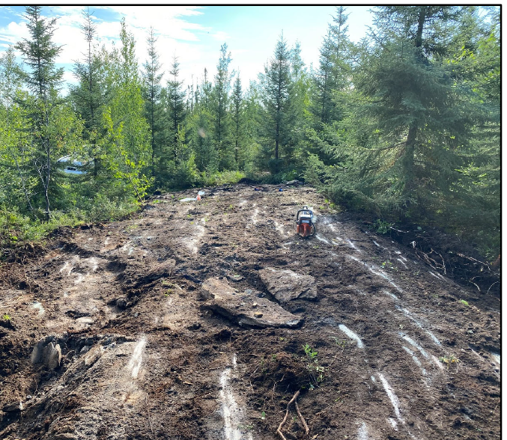
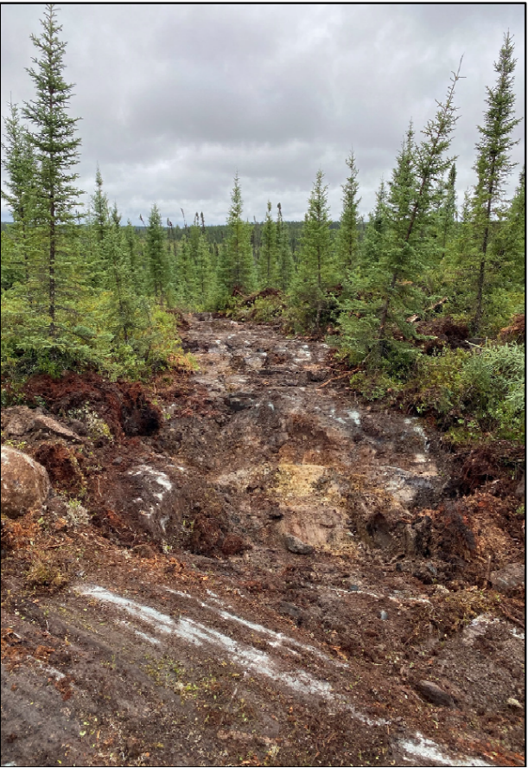
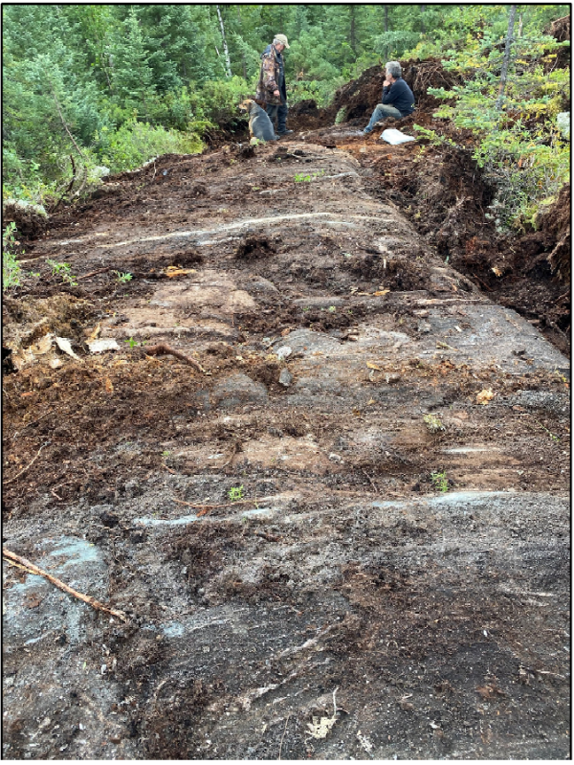
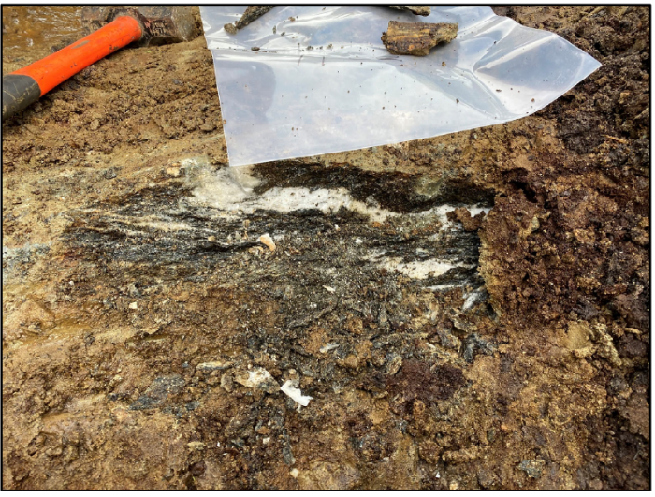
Quebec Nickel
Project Exploration
Shear Zones Discovered on Project
Discovery Shear Zone
40 Foot Shear Zone
North Shear Zone
South Shear Zone

Slide 12
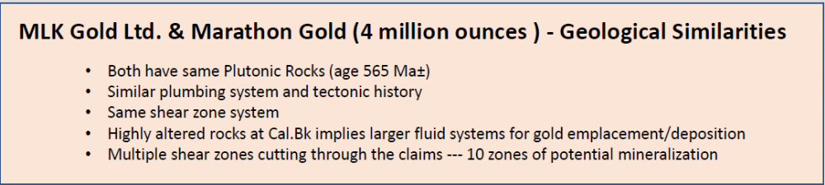
Newfoundland
Project
Caledonia Brook Project located in Major Gold Bearing Trend in Newfoundland
Caledonia Brook
The property hosts mesothermal lode gold mineralization on the Valentine Lake Structural Trend, which hosts Marathon Gold’s Valentine Lake gold deposit to the southwest and
New Found Gold’s high grade mineralization along the parallel Appleton Fault Trend to the northeast.
40 Foot Shear Zone

Slide 13
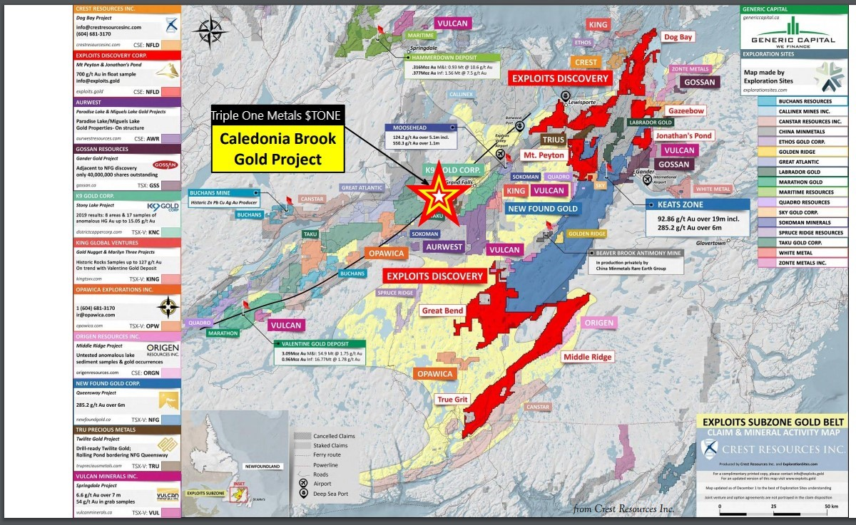
Newfoundland Project
Caledonia Brook Project located in Major Gold Bearing Trend in Newfoundland
40 Foot Shear Zone
North Shear Zone

Slide 14
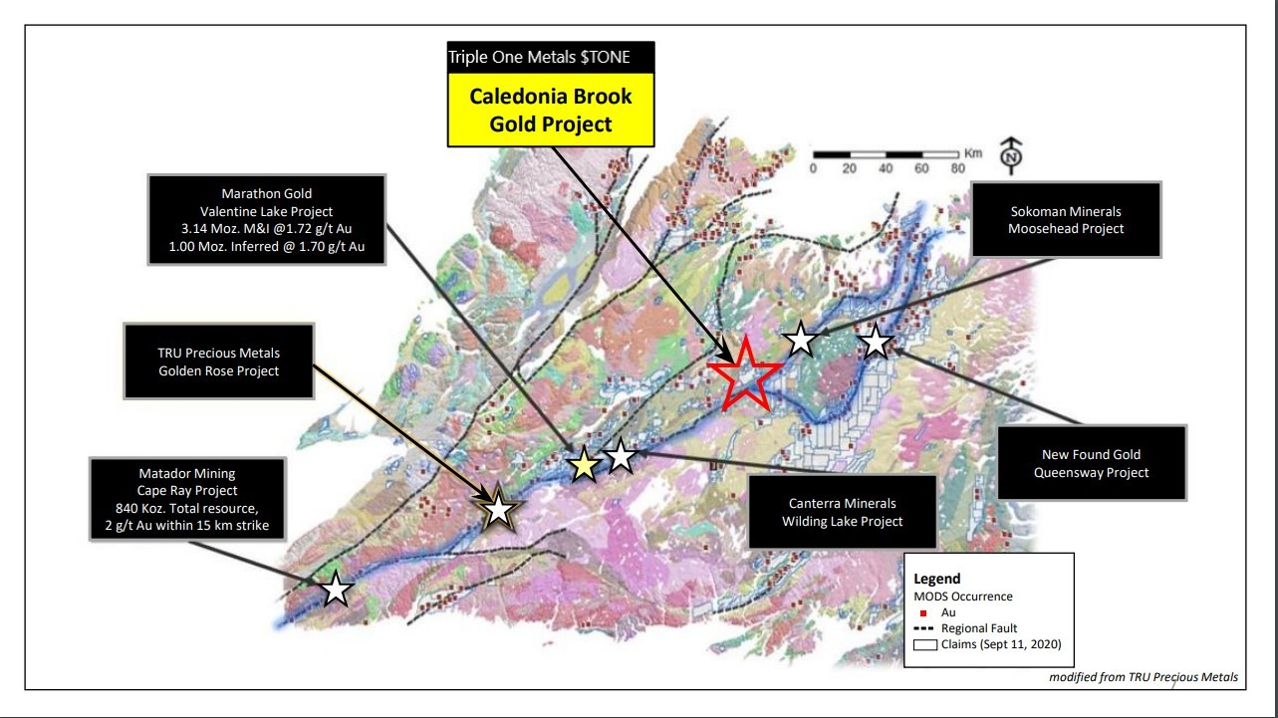
Newfoundland Project
Caledonia Brook Project located on trend with Newfound Gold and Marathon
40 Foot Shear Zone
North Shear Zone

Slide 15
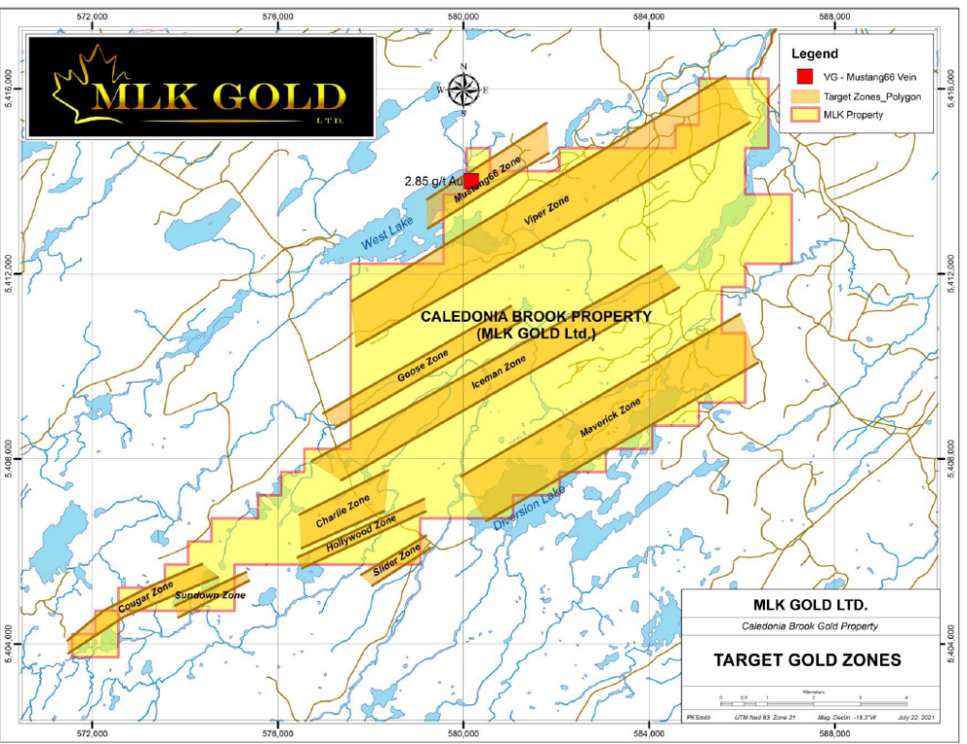
Newfoundland Project
Caledonia Brook Project located on trend with Newfound Gold and Marathon
40 Foot Shear Zone
North Shear Zone

Slide 16
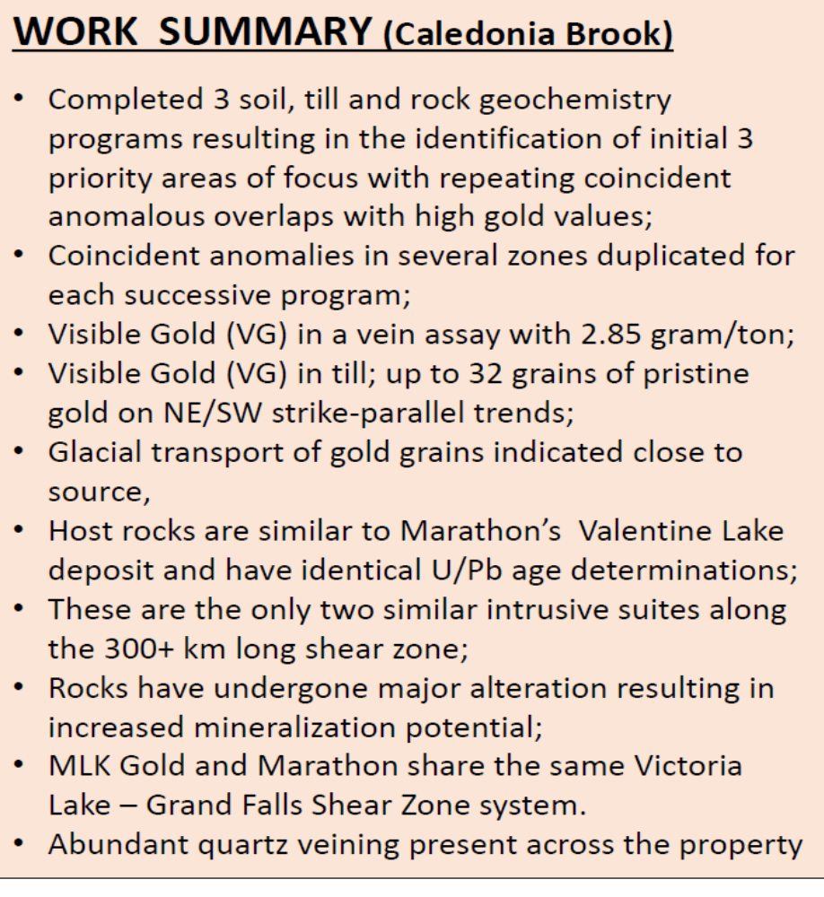
Newfoundland Project
Caledonia Brook Project located on trend with Newfound Gold and Marathon
40 Foot Shear Zone
North Shear Zone

Slide 17
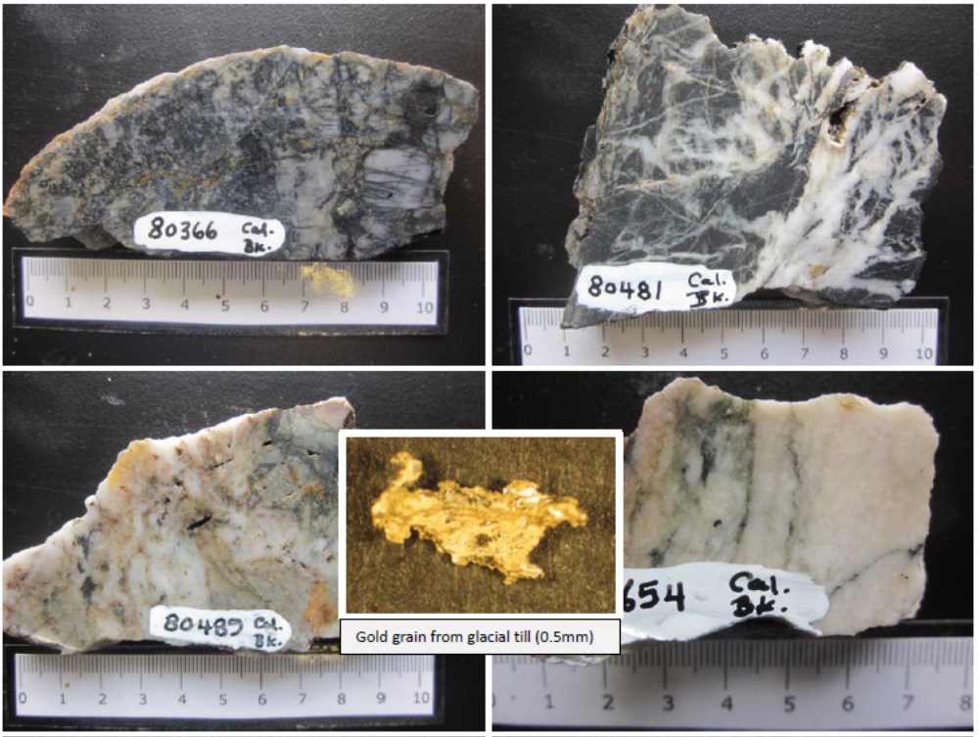
Newfoundland Project
Caledonia Brook Project located on trend with Newfound Gold and Marathon
40 Foot Shear Zone
North Shear Zone

Slide 18
Share Structure
Triple One Metals | Shares | Warrants
Share Outstanding | 29,544,815 | 11,815,642 @ .28 6,786,200 @ .20
NFT Financing $250,000 @.05 | 5,000,000 | 5,000,000 @.10
Post Financing Issued and Outstanding Shares & Warrants | 34,544,815 | 23,601,842
Fully Diluted + Cash inflow | 58,146,657 | $ 5,165,620

Slide 19
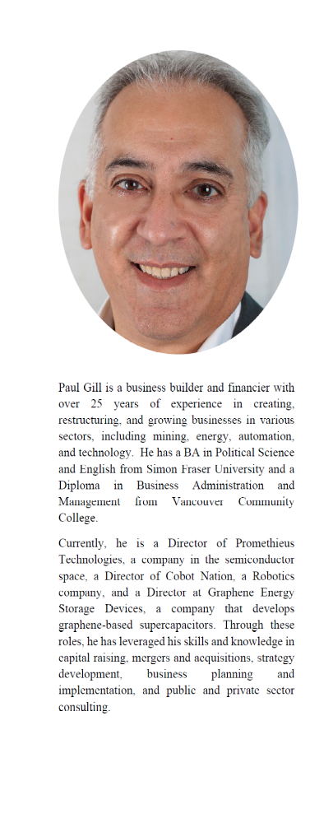
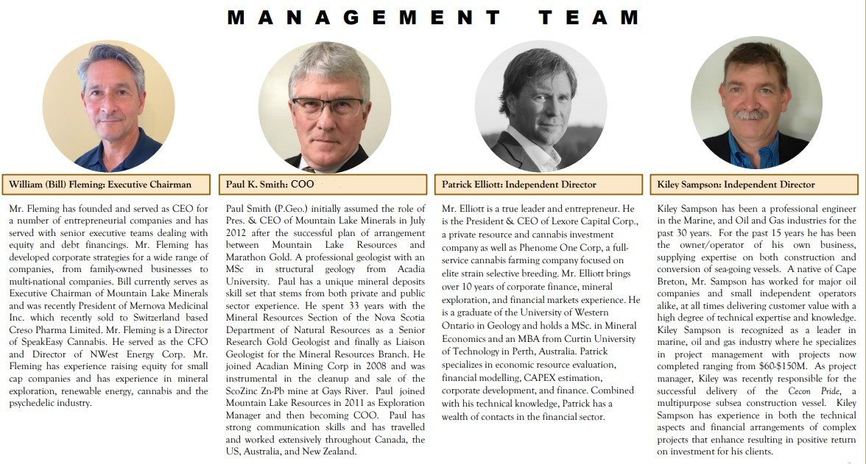
A. Paul Gill, CEO

